Slide 1
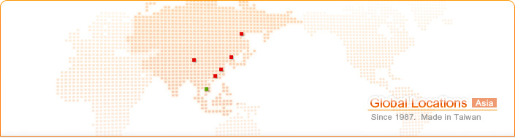
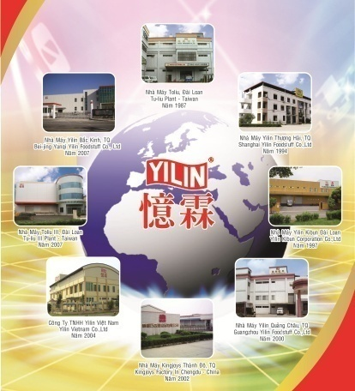
YILIN GROUP
Taiwan (3)
Douliu Plant, Douliu Plant II(Functional Foods), Yilin Kibun Corporation
China (5)
Vietnam (1)
Shanghai、Guangzhou、Beijing 、Zhangzhou、Chengdu
Ho Chi Minh City Vietnam

Slide 2
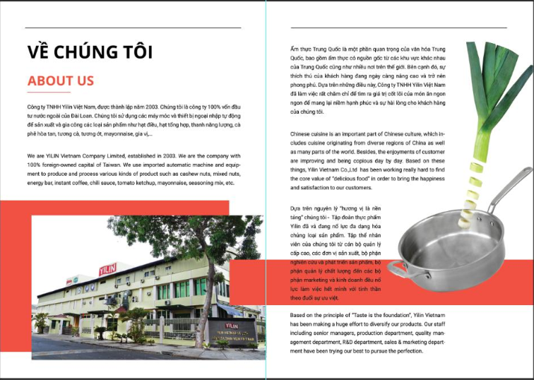

Slide 3


Five big spirits
As manufacturer of flavorings with a heavy responsibility, Yilin thoroughly implement the "Safety", "delicious," "innovation", "convenience", "health" these five essentials. Also, to meet customer needs, promote the realization of a stable food culture development and continuity. For the future, expect to be sustainable, be at the food industry summit.
Certification
*HACCP
* ISO 9001
* HALAL

Slide 4
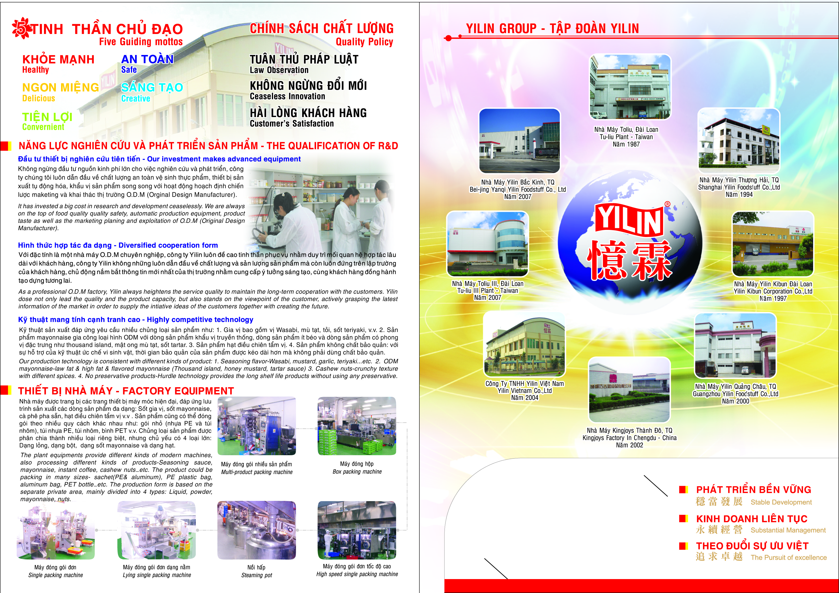
Notes:
OBM?
ODM?
OEM?

Slide 5
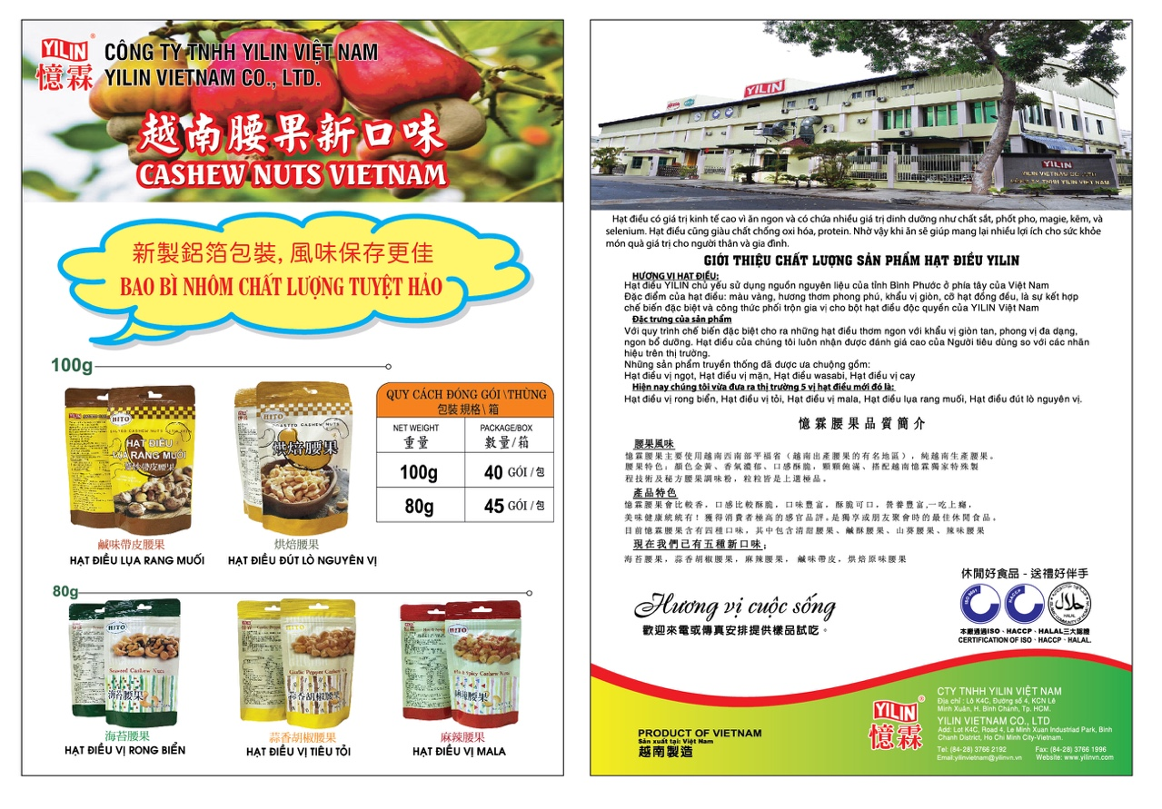

Slide 6
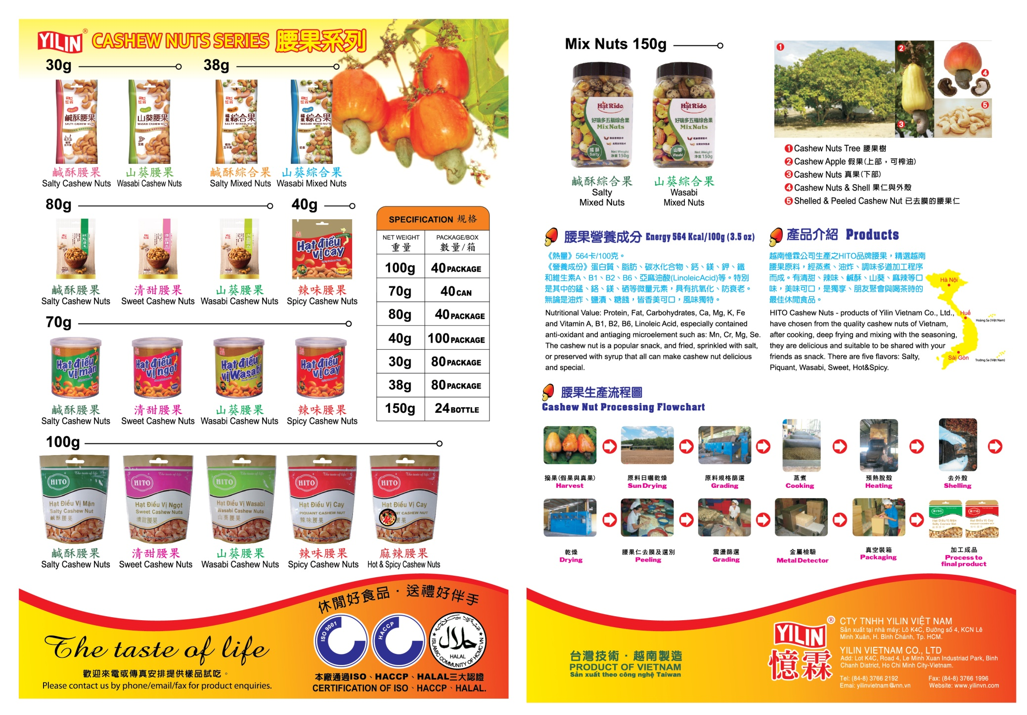

Slide 7
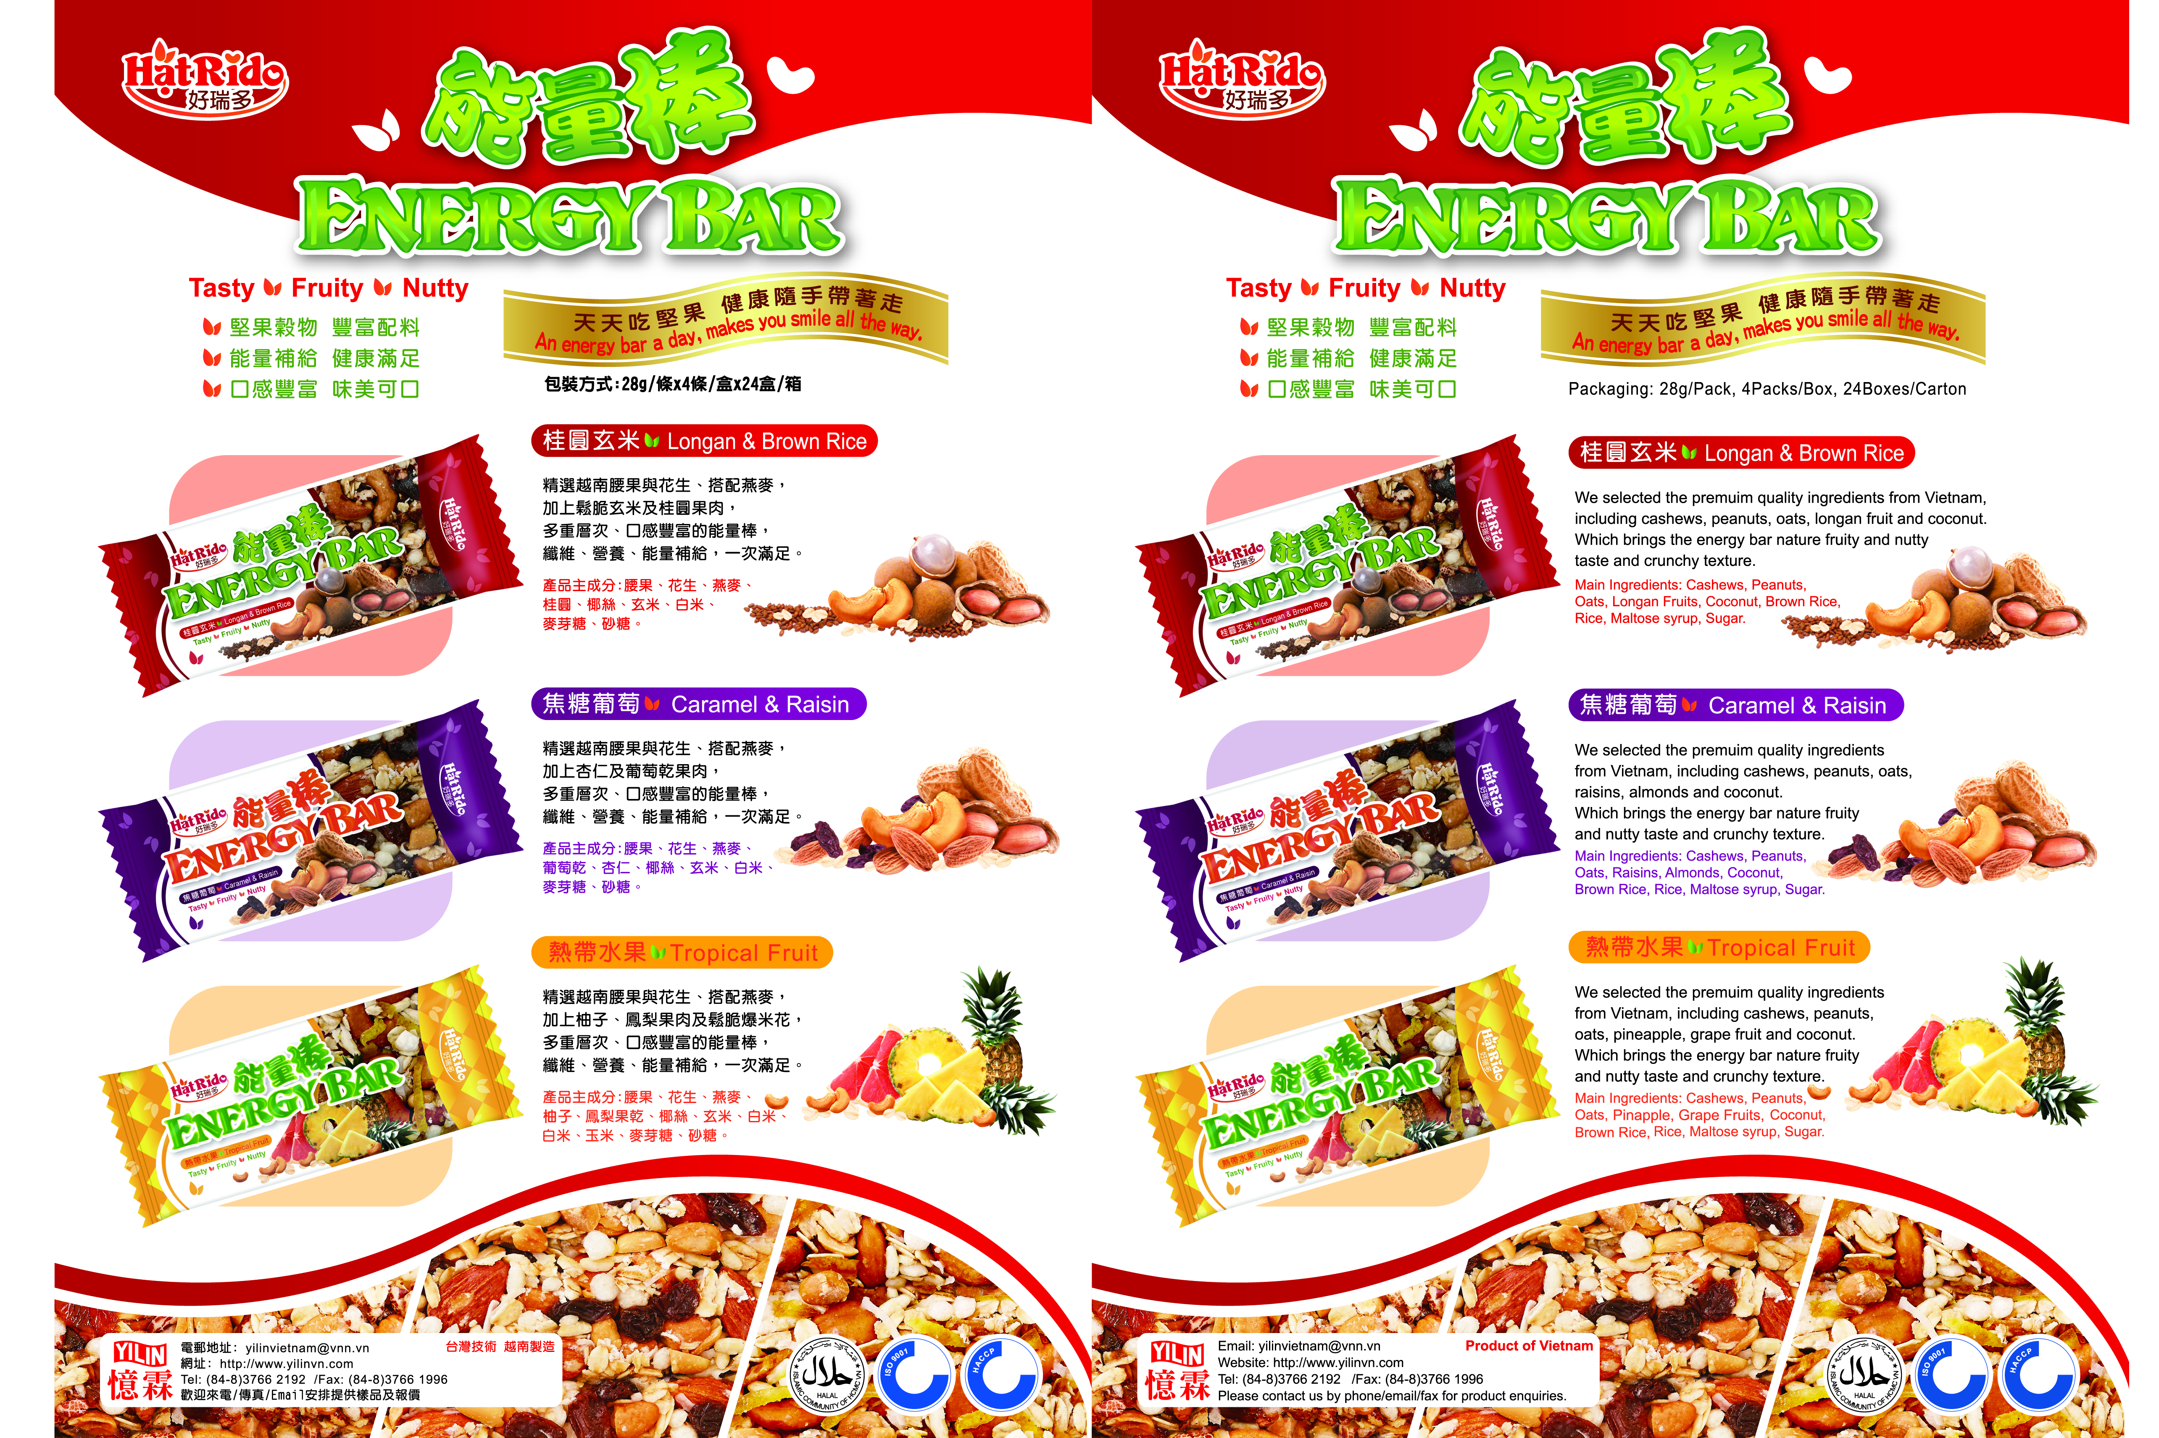

Slide 8
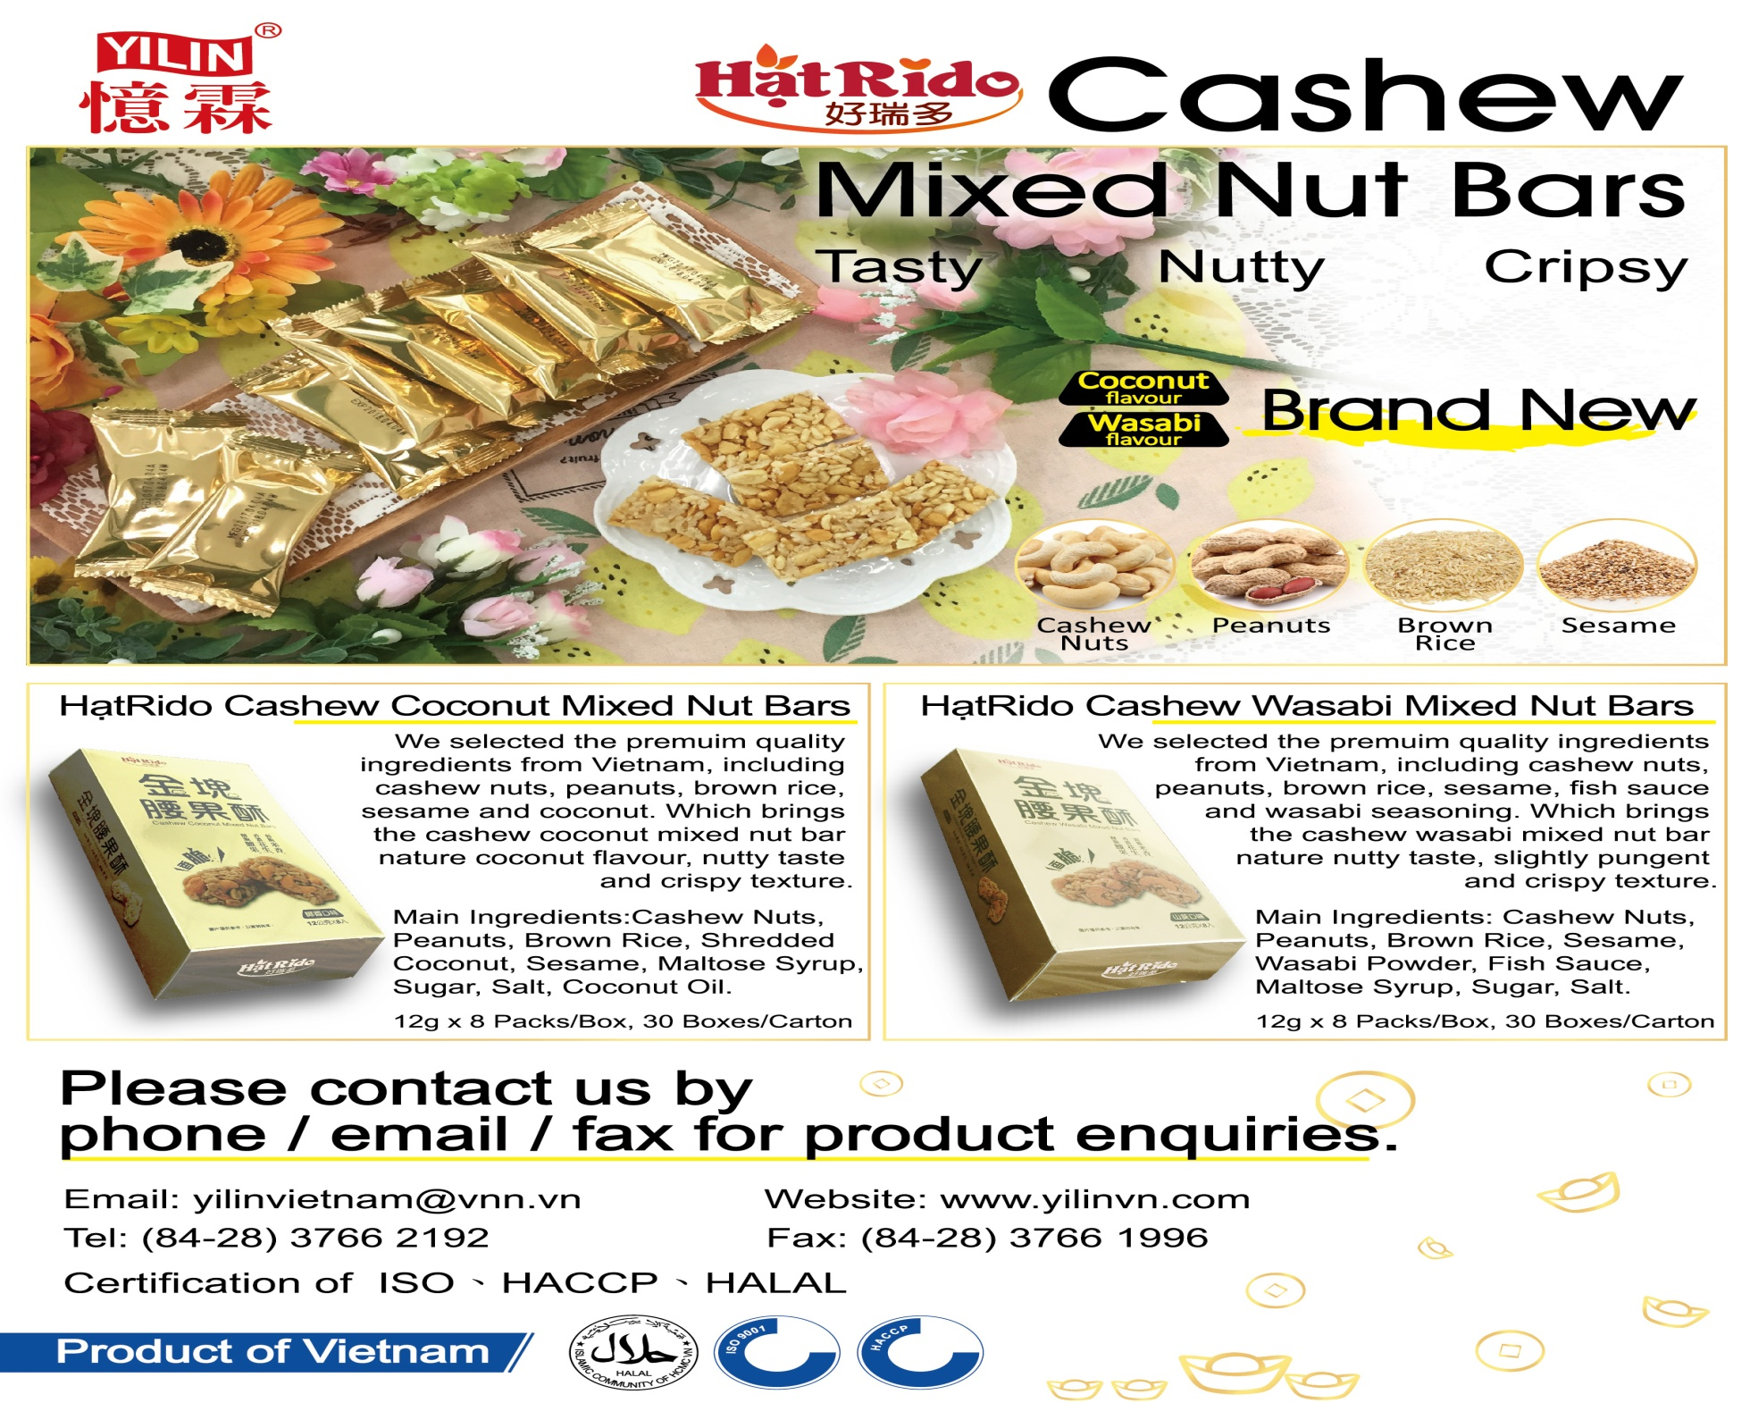

Slide 9
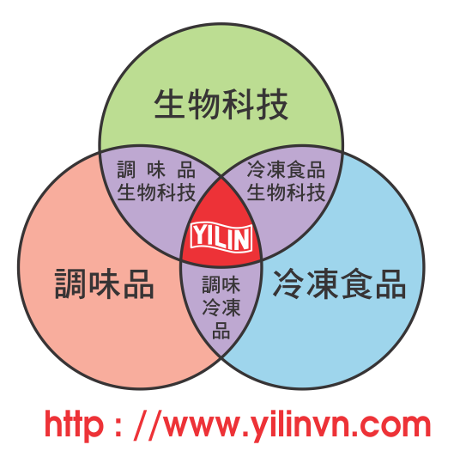
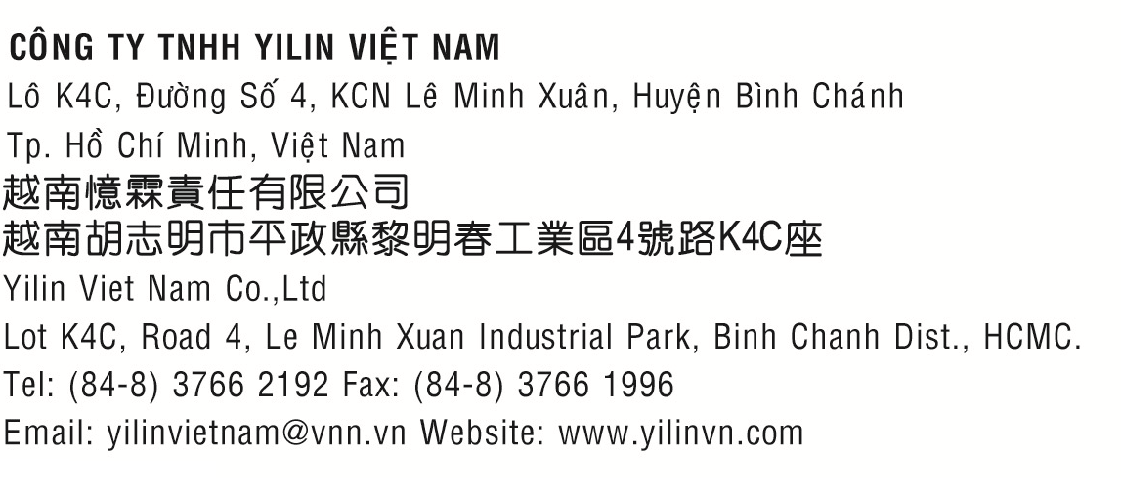
联系方式 Contact method

